Slide 1
Value of Diversity In The Workplace
Notes:
Let’s take a closer close at the issue of diversity in organizations.

Slide 2
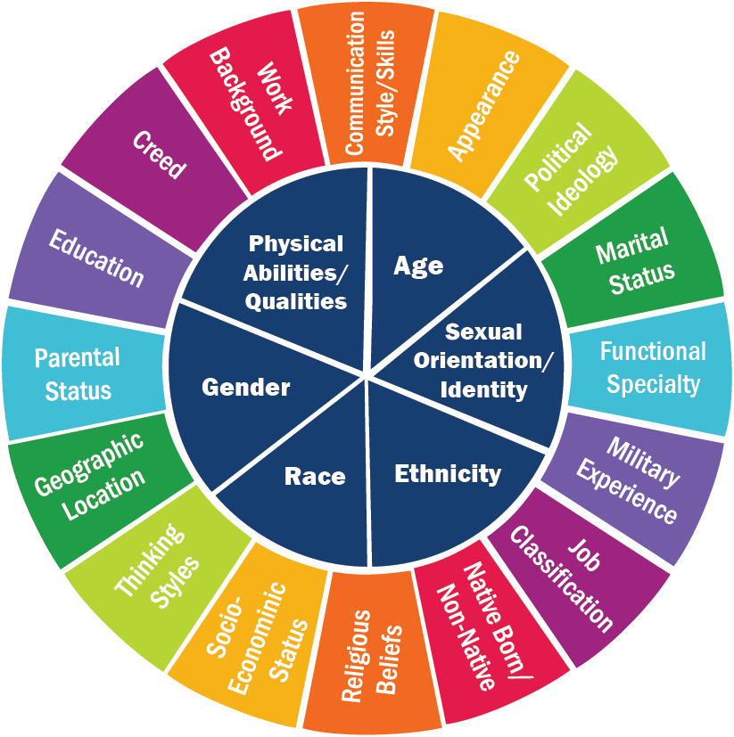
DIVERSITY IS A COMPLEX ISSUE
Notes:
Diversity is a complex and critically important issue. With our JUST Framework, we only ask organizations to disclose data on gender balance and racial-ethnic diversity. To build a truly inclusive workforce, organizations should consider a much broader list of qualities, as depicted in our color wheel.. As you can see, there are an additional 16 elements of diversity represented on the outer ring. It is our hope that the JUST Program will allow organizations to begin the process of looking more closely at whether their organization is as diverse as the communities in which they operate and to develop strategies to be more inclusive over time.

Slide 3
Notes:
132 companies in North America employing more than 4.6 million people shared their pipeline data and completed a survey of HR practices. While women represent 49% of the entry level positions in these companies, they represent only 20% of C-Suite positions.

Slide 4
Gender Diversity of ASLA Membership
Notes:
In 2000, women representation in the AIA was at 9%. The Bureau of Labor Statistics (BLS) reports that in 2013, 25% of the 193,000 people working as “architects, except naval” in the United States were women. Architecture Students: In its most recent annual report (2013), the National Architectural Accrediting Board (NAAB) indicates that 43% of a total of 25,958 enrolled students in NAAB-accredited architecture programs (B.Arch, M.Arch, and D.Arch) in 2012-13 were female. AIA demographics from 2012 survey.

Slide 5
Racial Diversity of AIA Membership
Notes:
There has been minimal progress to attracting or recruiting more minorities to work in the design profession. While African Americans represent about 12% of the U.S. population, they comprise less than 2% of the field of practicing architects.

Slide 6
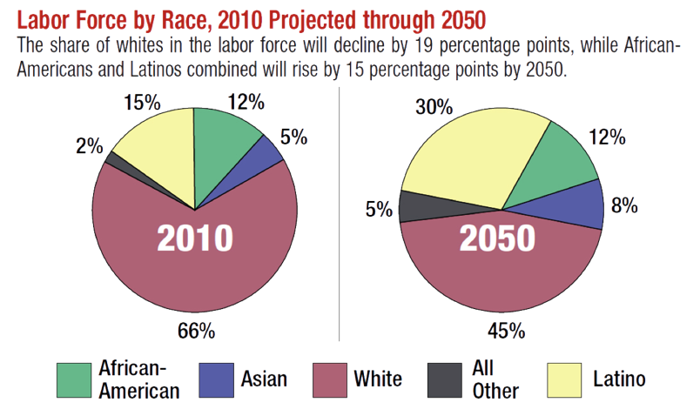
Notes:
The U.S. Census Bureau projects that by the year 2042 U.S. residents who identify themselves as Latino, African American, Asian, American Indian, Native Hawaiian, and Pacific Islander will together outnumber non-Hispanic whites, meaning that ethnic and racial minorities will comprise a majority of the nation’s population in less than 30 years from today. Last year, the overall number of Latino, African-American, and Asian students in public K-12 classrooms surpassed the number of non-Hispanic whites. As you can see from this chart, The nation’s labor force as projected to 2050 will reflect these shifting demographics.

Slide 7
THE BUSINESS CASE FOR DIVERSITY

Slide 8
“Gender diversity can improve team decision-making and improve innovation capabilities for development of new products or services,”
Jessica Alsford,
Managing Director,
Morgan Stanley

Slide 9
GENDER EQUALITY IN C-SUITE DRIVE PROFITS
Ernst & Young analyzed results from 22,000 global, publicly traded companies, in 90 countries from various industries and showed that having at least 30% of women in leadership positions, or the “C-suite,” adds up to 6% to net profit margin.
Notes:
The research considered 13,000 profitable companies, which had a median net profit margin of 6.4 percent, and found that the margin increased by more than 1 percentage point, or about 15 percent, when women filled at least 30 percent of leadership roles. This effect was "even more striking" when unprofitable companies were included in the analysis, the report said. The combined 22,000 companies had a median net profit margin of just over 3 percent; those with 30 percent women in top roles posted profit margins as much as 6 percentage points more.

Slide 10
“In the U.S., there is a linear relationship between racial diversity and better financial performance: for every 10% increase in racial diversity on the senior leadership team, earnings (EBIT) rise 1%.”

Slide 11
WIN THE QUEST FOR TOP YOUNG TALENT
Multiple surveys have indicated that diversity is particularly important to Millennials.
Notes:
50% of all infants under the age of 1 in 2010 in the U.S. were members of a racial and ethnic minority group.

Slide 12
BUILD COMPETITIVE ADVANTAGE
By committing to diversity as a strategic imperative, companies better position themselves to meet the needs of a multi-cultural diverse client base.
Notes:
Diversity helps companies react more effectively to market shifts and new customer needs. CEOs from many different industries are increasingly adopting the view that it is crucial for a company’s employees to reflect the people they serve. If a U.S. based design firm seeks to win projects in China for example, having designers on staff who are culturally and linguistically fluent can serve as a competitive advantage to winning and retaining new clients.

Slide 13
IMPROVE EMPLOYEE SATISFACTION
Diverse workplaces and inclusive H.R. practices increases employee satisfaction and fosters positive attitudes in the workplace.

Slide 14
BOOSTS CREATIVITY AND INNOVATION
Diversity fosters innovation and creativity through a greater variety of problem-solving approaches, new perspectives, broader thinking and fresh ideas.
Notes:
A Diverse workforce will likely improve creativity, innovation and problem solving by bringing in a wider perspective and insights and new ideas.

Slide 15
WHY DIVERSITY MATTERS
CLIENT SATISFACTION
FINANCIAL PERFORMANCE
DEVELOP REPUTATION
INCREASED ADAPTABILITY
COMPETITIVE EDGE
INCREASED INNOVATION
EMPLOYEE RECRUITMENT
EMPLOYEE RETENTION
EMPLOYEE ENGAGEMENT
Notes:
When organizations commit to building a diverse and inclusive workforce, we see a wide range of positive outcomes. Organizations build a better reputation in the marketplace and note higher levels of customer satisfaction. With a diverse workforce, organizations benefit from increased levels of workforce innovation and creativity. In many industries, higher levels of creativity will directly correlate to better products and services and a long-term competitive advantage. Finally, a diverse workforce will facilitate the hiring of top talent, create the conditions for higher levels of retention, and allow for higher levels of engagement.

