Slide 1
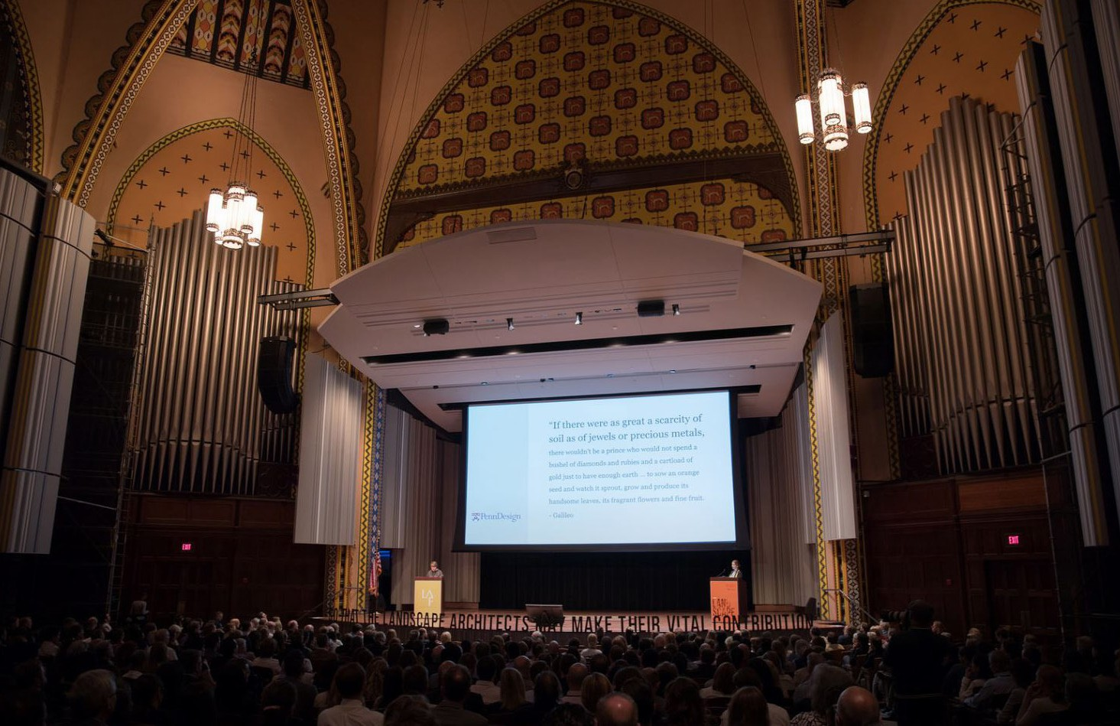
Resonate and Respond—

Slide 2
Resonate and Respond—
HOW THE NEW LANDSCAPE DECLARATION HAS INFLUENCED PRACTICE, RESEARCH, AND SCHOLARSHIP
JENNIFER GUTHRIE- FOUNDING PRINCIPAL , GGN
DAVID MALDA- PRINCIPAL , GGN
PEG STAEHELI- FOUNDING PRINCIPAL , MIG | SvR
DEBRA GUENTHER- PARTNER, MITHUN
DOROTHY FARIS- PRINCIPAL, MITHUN

Slide 3
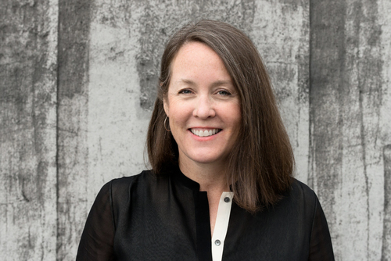

Jennifer guthrie
PHOTO COURTESYLAND 8
FASLA, PLA
FOUNDING PRINCIPAL
RESONATE
“Across borders and beyond walls, from city centers to the last wilderness, humanity’s common ground is the landscape itself. Food, water, oxygen – everything that sustains us comes from and returns to the landscape. What we do to our landscapes we ultimately do to ourselves. The profession charged with designing this common ground is landscape architecture.”
VOLUNTEERISM
PROJECT NAME / DOCUMENT TITLE / MONTH ##, 20## DRAFT/CONFIDENTIAL

Slide 4

LANDSCAPE ARCHITECTURE FOUNDATION

Slide 5
LANDSCAPE ARCHITECTURE FOUNDATION
Founded in 1966
Mission to support the preservation, improvement and enhancement of the environment.

Slide 6
LAF LANDSCAPE ARCHITECTURE FOUNDATION
LAF’s mission is to support the preservation, improvement and enhancement of the environment.
The Society's mission is to advance landscape architecture through advocacy, communication, education, and fellowship.
ASLA AMERICAN SOCIETY OF LANDSCAPE ARCHITECTS
TCLF educates and engages the public to make our shared landscape heritage more visible, identify its value, and empower its stewards.
TCLF THE CULTURAL LANDSCAPE FOUNDATION

Slide 7
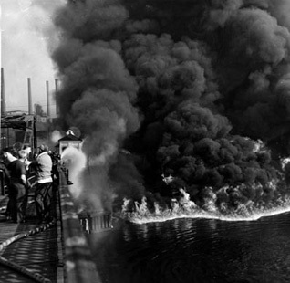
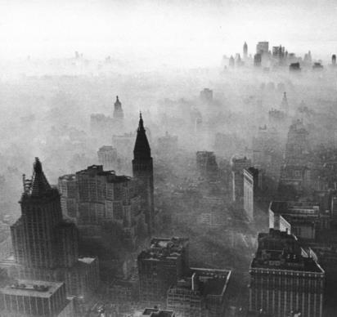
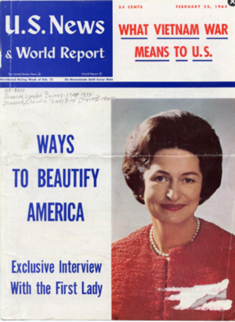

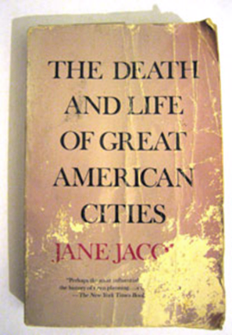

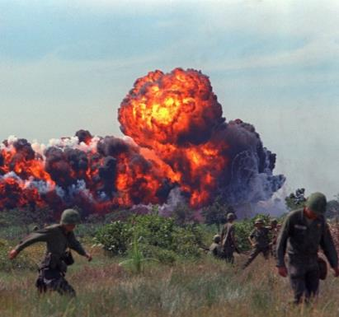
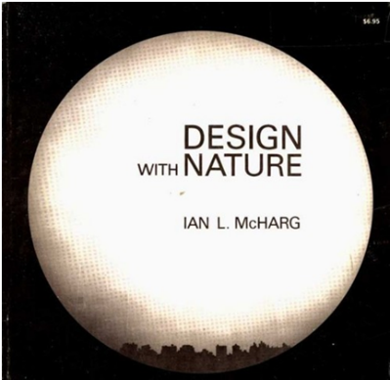
Notes:
The 1966 Declaration was very much a product of its era – a time of increasing awareness about the environment and growing discontent and activism that ultimately led to the passage of a slew of environmental legislation and the creation of the EPA.
Notes on images:
Death and Life of Great American Cities 1961
Silent Spring 1962
White House Conference on Natural Beauty
Washington, DC, May 24-25, 1965
Participants included: E. Bacon, G. Clay, G. Eckbo, C. Eliot II, Gutheim, L. Halprin, J. Jacobs, K. Lynch, I. McHarg, J. Rouss, H. Sasaki, RE Simon, J. Simonds, C. Tunnard, C. Wirth, W. Whyte
Manhattan Smog, USA, 1966
Napalm strike, Vietnam 1966
An oil slick on the Cuyahoga River - polluted from decades of industrial waste - caught fire on a Sunday morning in June 1969 near the Republic Steel mill, causing about $100,000 worth of damage to two railroad bridges.
Design with Nature 1969

Slide 8
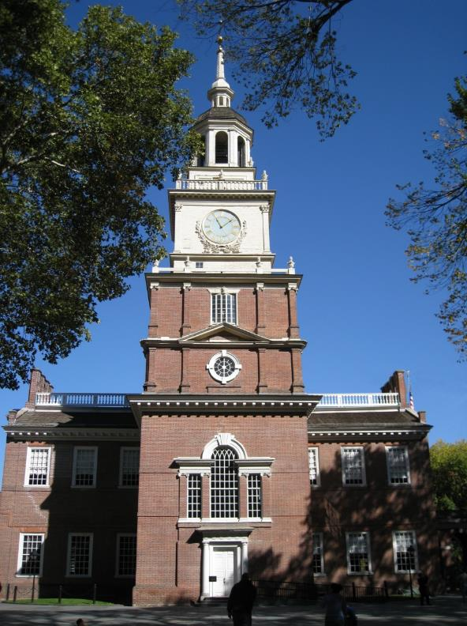
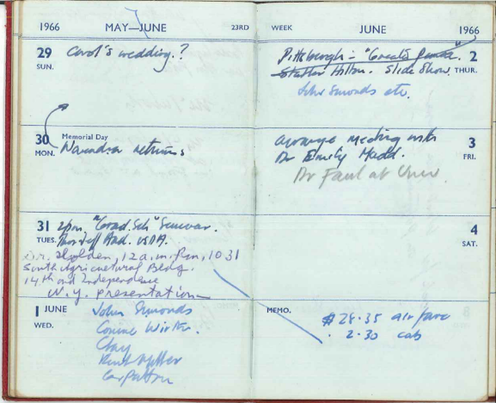
1966 DECLARATION OF CONCERN
June 1-2, 1966
Independence Hall in Philadelphia
Six signers
  Campbell Miller
  Grady Clay
  Ian L. McHarg
  Charles R. Hammond
  George E. Patton
  John O. Simonds
Notes:
The Landscape Architecture Foundation was founded in 1966, and one of LAF’s first big initiatives was the release of its “Declaration of Concern”.
This seminal document was drafted by Ian McHarg, Grady Clay, and 4 other leading landscape architects of the day.
As the story goes, they assembled at Independence Hall in Philadelphia. Unfortunately, we don’t have any photos or records of this gathering aside from <click> this journal entry from McHarg, where on June 1 you can see the names of the other signers listed.

Slide 9
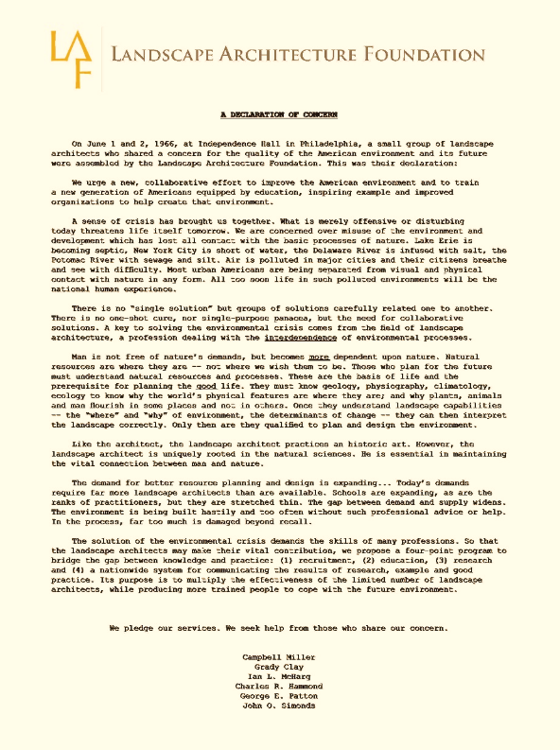
1966 DECLARATION OF CONCERN
Current issues
Agency of landscape architects
Strategies to increase capacity of landscape architects to help solve these issues
Notes:
The Declaration of Concern has 3 main sections.
The first paragraph discusses key issues of the day: Pollution and silt in key waterways, air pollution in major cities, the increasingly urban population being separated from visual and physical contact with nature.
The next section discusses the unique skills of landscape architects and why they are essential to help address these issues.
The final paragraph proposes a strategies to increase the capacity of landscape architects to help solve these issues.

Slide 10
1966 DECLARATION OF CONCERN
A sense of crisis has brought us together. What is merely offensive or disturbing today threatens life itself tomorrow. We are concerned over misuse of the environment and development which has lost all contact with the basic processes of nature. Lake Erie is becoming septic, New York City is short of water, the Delaware River is infused with salt, the Potomac River with sewage and silt. Air is polluted in major cities and their citizens breathe and see with difficulty… All too soon life in such polluted environments will be the national human experience.
Notes:
The 1966 Declaration of Concern is a strong critique of the unchecked development that the signers saw happening across the U.S.
They state their belief that we were in a state of environmental crisis and heralded landscape architecture as a discipline critical to help solve it.

Slide 11
1966 DECLARATION OF CONCERN
The solution of the environmental crisis demands the skills of many professions. So that the landscape architects may make their vital contribution, we propose a four-point program to bridge the gap between knowledge and practice:
  recruitment,
  education,
  research and
  a nationwide system for communicating the results of research, example and good practice.
Its purpose is to multiply the effectiveness of the limited number of landscape architects, while producing more trained people to cope with the future environment.
Notes:
The 1966 Declaration of Concern is a strong critique of the unchecked development that the signers saw happening across the U.S.
They state their belief that we were in a state of environmental crisis and heralded landscape architecture as a discipline critical to help solve it.

Slide 12
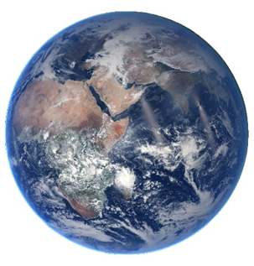
LAF KEY PROGRAMS TODAY
Research
  Landscape Performance Series
  Case Study Investigation (CSI)
Scholarships
  LAF Scholarships & Fellowships
  Olmsted Scholars Program
Leadership
  LAF Fellowship for Innovation and Leadership

Slide 13
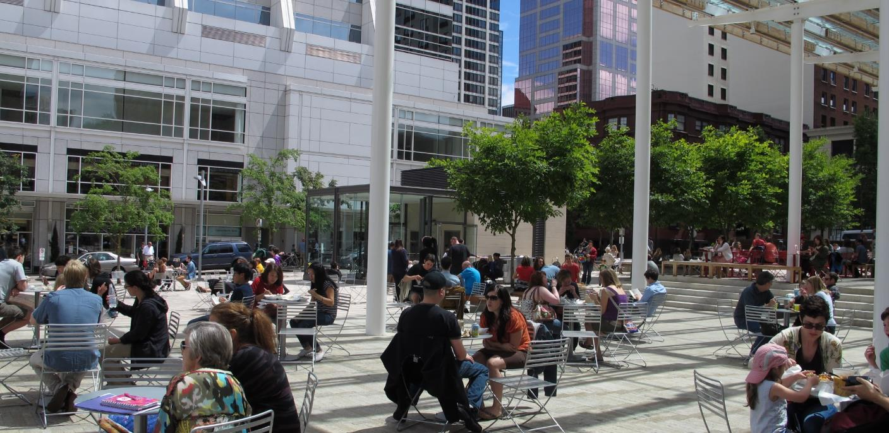
DIRECTOR PARK PORTLAND, OR | OLIN
Attracts an average of 1,495 people per day in summer and 376 per day in winter.
Generates an average annual gross revenue of over $34,000 in event rentals.
Created 8 full-time jobs, including two maintenance staff, an events coordinator, and café employees.
Notes:
Attracts an average of 1495 people per day during summer months (June through September). Of these visitors, 96% engaged in recreational activities, 87% of which were also social activities. Average daily winter visitation (November through February) is 376 users. Summer visitation increased 19% between 2010 and 2012 and winter visitation increased 50%. These figures do not include event attendance.
Generates an average annual gross revenue of over $34,000. Between 2010 and 2013 the park generated $140,000 in revenue from event rentals—an average annual gross revenue over $34,000. Annual gross income increased 91% between 2010 and 2013.﻿
Creates jobs, supporting two full-time maintenance staff, an events coordinator, and numerous part-time park host positions. The park cafe also employs five full-time equivalent (FTE) employees. ﻿
http://www.lafoundation.org/research/landscape-performance-series/case-studies/case-study/595/

Slide 14
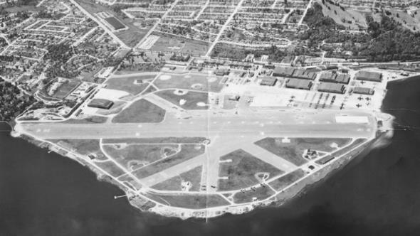
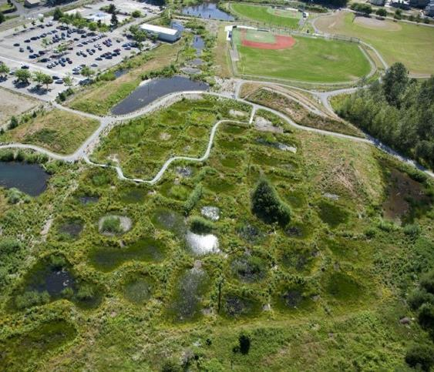
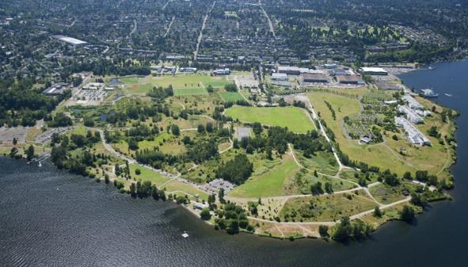
MAGNUSON PARK WETLANDS SEATTLE, WA | BERGER PARTNERSHIP
BEFORE
Reduces TSS by 94% and fecal coliform bacteria by 99%.
Increased Pacific Chorus Frog larvae population by 255%.
Provides hands-on education for ~1,000 park stewards.
AFTER
AFTER
Notes:
Reduces suspended solids by 94%, fecal coliform bacteria by 99%, and increases dissolved oxygen by 32% as stormwater runoff travels through wetlands, according to monitoring data.
Increased species richness in the park, as represented by a 255% increase in the Pacific Chorus Frog larvae population and an increase from 18 to 21 species of dragonfly or damselflies from 2010 to 2011. ﻿
Has provided hands-on volunteer and educational opportunities to 2,500 students and approximately 1,000 park and wetlands land stewards and maintenance volunteers. Activities include tree plantings, nature experiments, data collection, invasive species removal, and establishing native plantings.﻿
https://lafoundation.org/research/landscape-performance-series/case-studies/case-study/435/

Slide 15
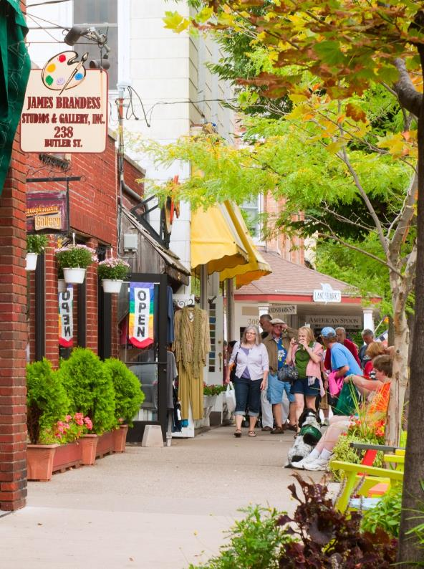
FAST FACT LIBRARY
Consumers are willing to spend 9-12% more for goods and services in central business districts with high quality tree canopy.
Wolf, Kathleen L., (2005). Business district streetscapes, trees, and consumer response. Journal of Forestry 103(8): 396-400 ﻿
Notes:
shutterstock_84347458 - http://www.shutterstock.com/pic.mhtml?id=84347458&src=id
Shops and galleries line Butler Street in Saugatuck, Michigan, on September 4, 2011. The many colorful venues are a major draw for thousands of visitors every year.
Editorial Use Only. Use of this image in advertising or for promotional purposes is prohibited.
Copyright: Kenneth Sponsler

Slide 16
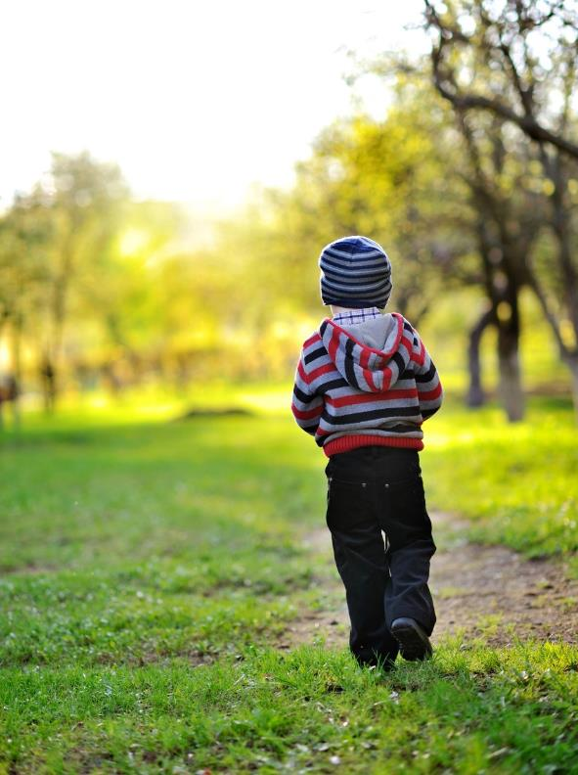
FAST FACT LIBRARY
Children with Attention Deficit Hyperactivity Disorder (ADHD) concentrate better after a walk in a city park than after walks in other urban settings.
Faber Taylor, Andrea, Kuo, Frances E., (2009). Children with attention deficits concentrate better after walk in the park. Journal of Attention Disorders, 12, 402-409.

Slide 17

LAF SCHOLARSHIPS
Leading provider of national awards for over 30 years
  Scholarships and fellowships
  Over $1.25 million in scholarships to 570 students since 1986
  Over $60,000 awarded each year
Support new generations of landscape architects by:
  Rewarding superior student performance
  Encouraging diversity
  Supporting original research
  Assisting with unmet financial need

Slide 18

LAF OLMSTED SCHOLARS PROGRAM
Growing community of over 450 scholars since 2008
Recognizing exceptional leadership potential
  Nominee from each LAAB-accredited program
  $25,000 Graduate award
  $15,000 Undergraduate award
  Six 1,000 finalists
90% of 75 eligible universities have participated
Employee recruitment tool
10 year Celebration in 2018

Slide 19


Slide 20
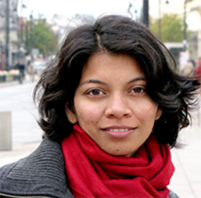
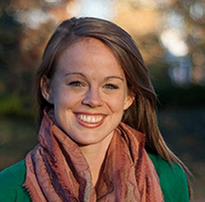
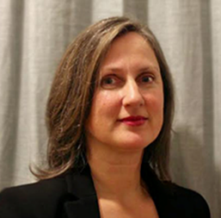
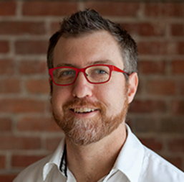
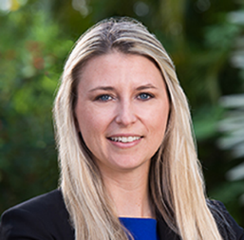
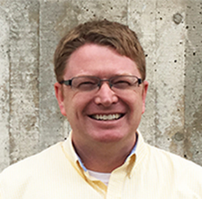
LAF FELLOWSHIP FOR INNOVATION
LSI Lead Sponsor of LAF 50 & Forward Campaign to launch the Fellowship 2017
$25,000 award
  Mid-career or established leaders
  3 three-day residencies in Washington, D.C.
  Devote 3 months’ time to a project
  Project or activity that is transformative to the practice of landscape architecture
3-5 fellowships per year
Final presentations at public symposium in May

Slide 21

LAF LEADERSHIP FOR THE FUTURE
Summit on Landscape Architecture and the Future
  June 10-11, 2016
  University of Pennsylvania
  75 leading global thinkers and influencers
  715 attendees
  Day 1: 25 “Declarations”
  Day 2: 9 Thematic panels
Develop the New Landscape Declaration
Notes:
The one-page, 367-word New Landscape Declaration took 4 months to finalize and it is the product of many drafts and probing discussions.
It is modeled after the 1966 Declaration of Concern, with its urgent yet hopeful message.
While it is a clear call to action for landscape architects, it is written in broad language to engage a wider audience
The Summit generated a tremendous amount of ideas and content, which is all available for free on the LAF website, including a fantastic 20-minute documentary film produced in collaboration with Penn and OLIN. You are encouraged to read the written Declarations and view the recordings. CEUs will be available soon.

Slide 22
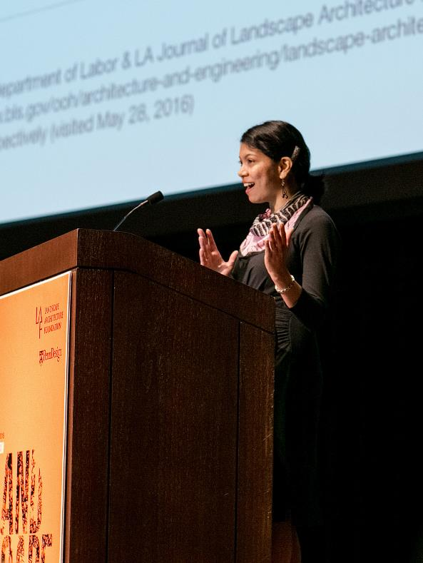
DECLARATIONS
Gerdo Aquino
Henri Bava
Charles Birnbaum
James Corner
Tim Duggan
Martha Fajardo
Gina Ford
Christophe Girot
David Gouverneur
Feng Han
Randy Hester
Nina-Marie Lister
Christopher Marcinkoski
Blaine Merker
Alpa Nawre
Patricia O'Donnell
Kate Orff
Mario Schjetnan
Martha Schwartz
Kelly Shannon
Dirk Sijmons
Carl Steinitz
Marc Treib
Charles Waldheim
Kongjian Yu
Notes:
On the first day, 25 leaders wrote 1,200-word Declarations and delivered these in a series of 10-minute talks. Their charge was to critically reflect on the achievements of landscape architecture over the last 50 years and to present bold ideas for what it should achieve in the future.

Slide 23
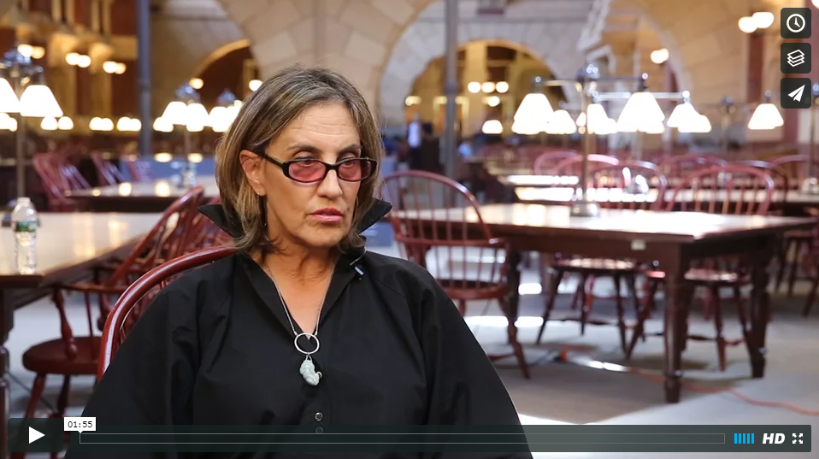
WHAT WAS SAID. . .
Notes:
Switch to play video on thumb/hard drive or through internet
Trailer 1 (Target: Landscape architecture audiences): https://vimeo.com/182116329
Trailer 2 (Target: Broader built environment audiences): https://vimeo.com/182121405
Full documentary: https://vimeo.com/181628669

Slide 24
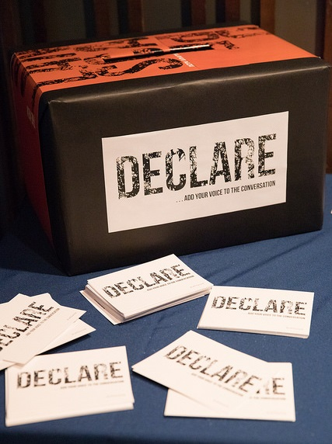
ENGAGEMENT
Polling
Social Media
Declare Cards
Notes:
Feedback from all attendees was sought and catalogued using audience polling, social media, and physical cards.

Slide 25
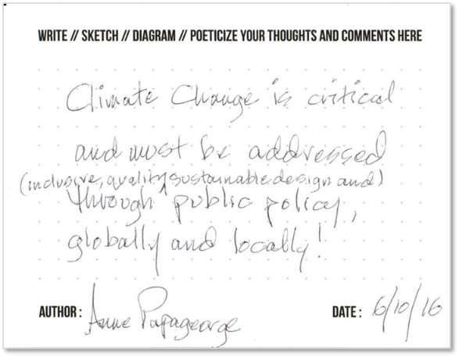
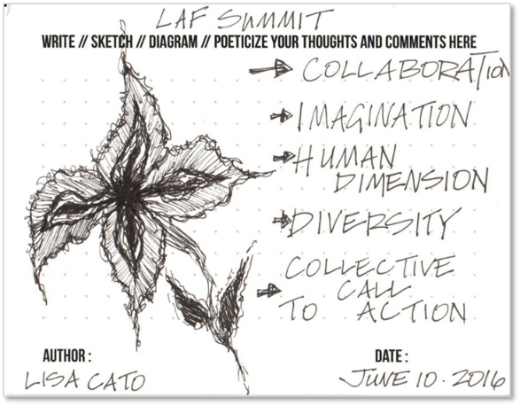
21ST CENTURY CALL TO ACTION
“I am EXCITED to be a
LANDSCAPE ARCHITECT again!”
Notes:
The attendees were incredibly engaged, sharing their ideas and inspiration – here are two of the 120+ Declare cards.

Slide 26
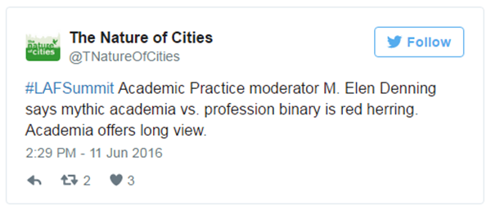
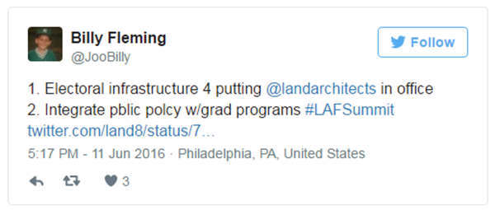
21ST CENTURY CALL TO ACTION
“I have SOMETHING
IMPORTANT to SAY!”
Notes:
Here are two of the many, many social media posts and conversations fostered by the Summit.

Slide 27
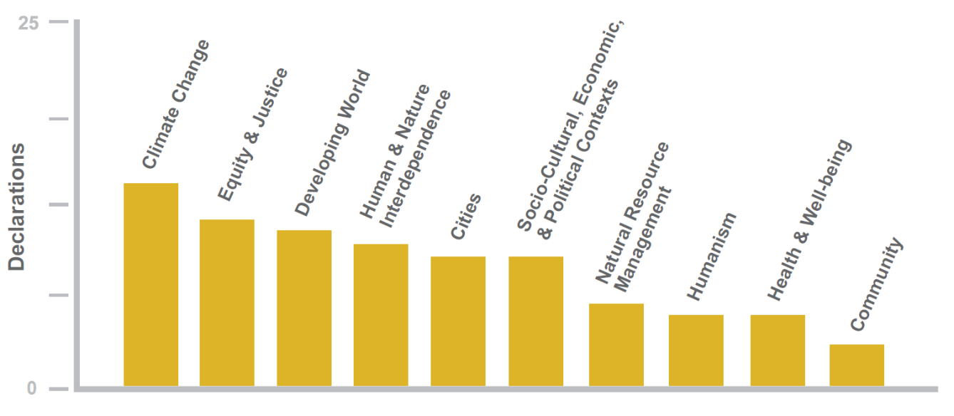
DECLARATIONS: COMMON THEMES
Notes:
Here are the common themes that rang through the Declarations.

Slide 28
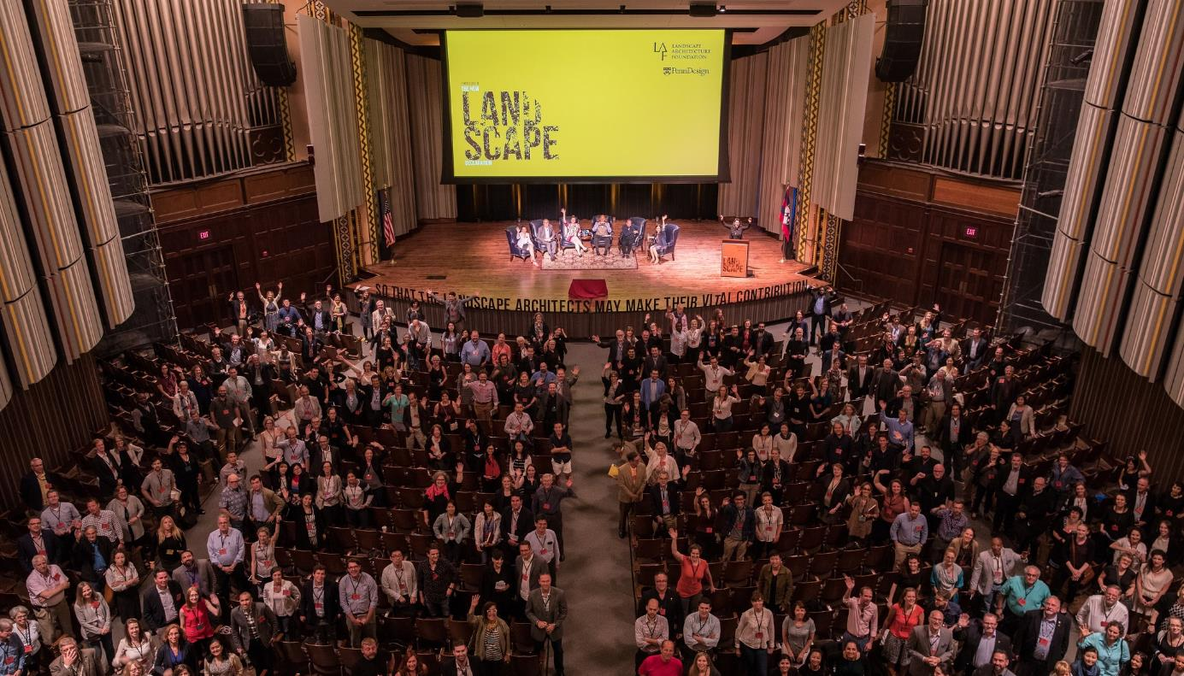
THE NEW
LANDSCAPE
DECLARATION
Notes:
A key product from the Summit and a synthesis of all of the ideas presented is the New Landscape Declaration.

Slide 29
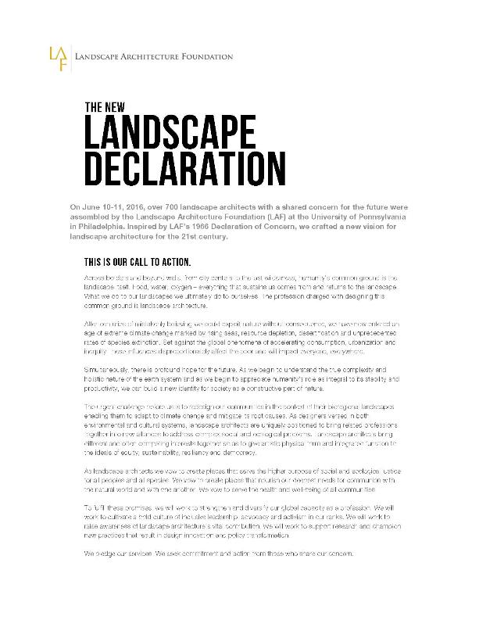
NEW LANDSCAPE DECLARATION
Humans need to be a constructive part of nature
Key issues
  Climate Change
  Consumption
  Urbanization
Agency of landscape architects
  Designers of both natural and cultural systems
  Positioned as synthesizers and collaborators
  Inform decision-making and policy
  Inequity
  Mass Species Extinction
Notes:
Key ideas from the New Landscape Declaration

Slide 30

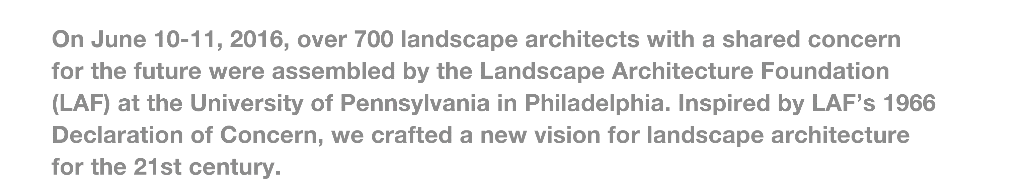

Notes:
Read it out loud, slowly

Slide 31
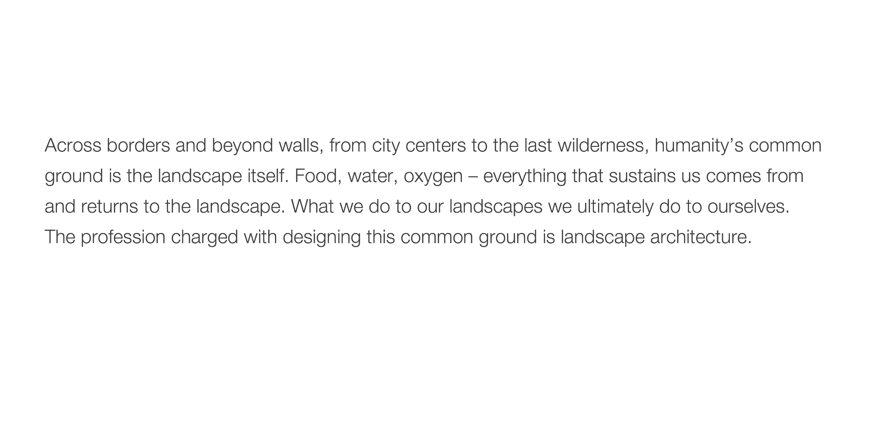

Slide 32
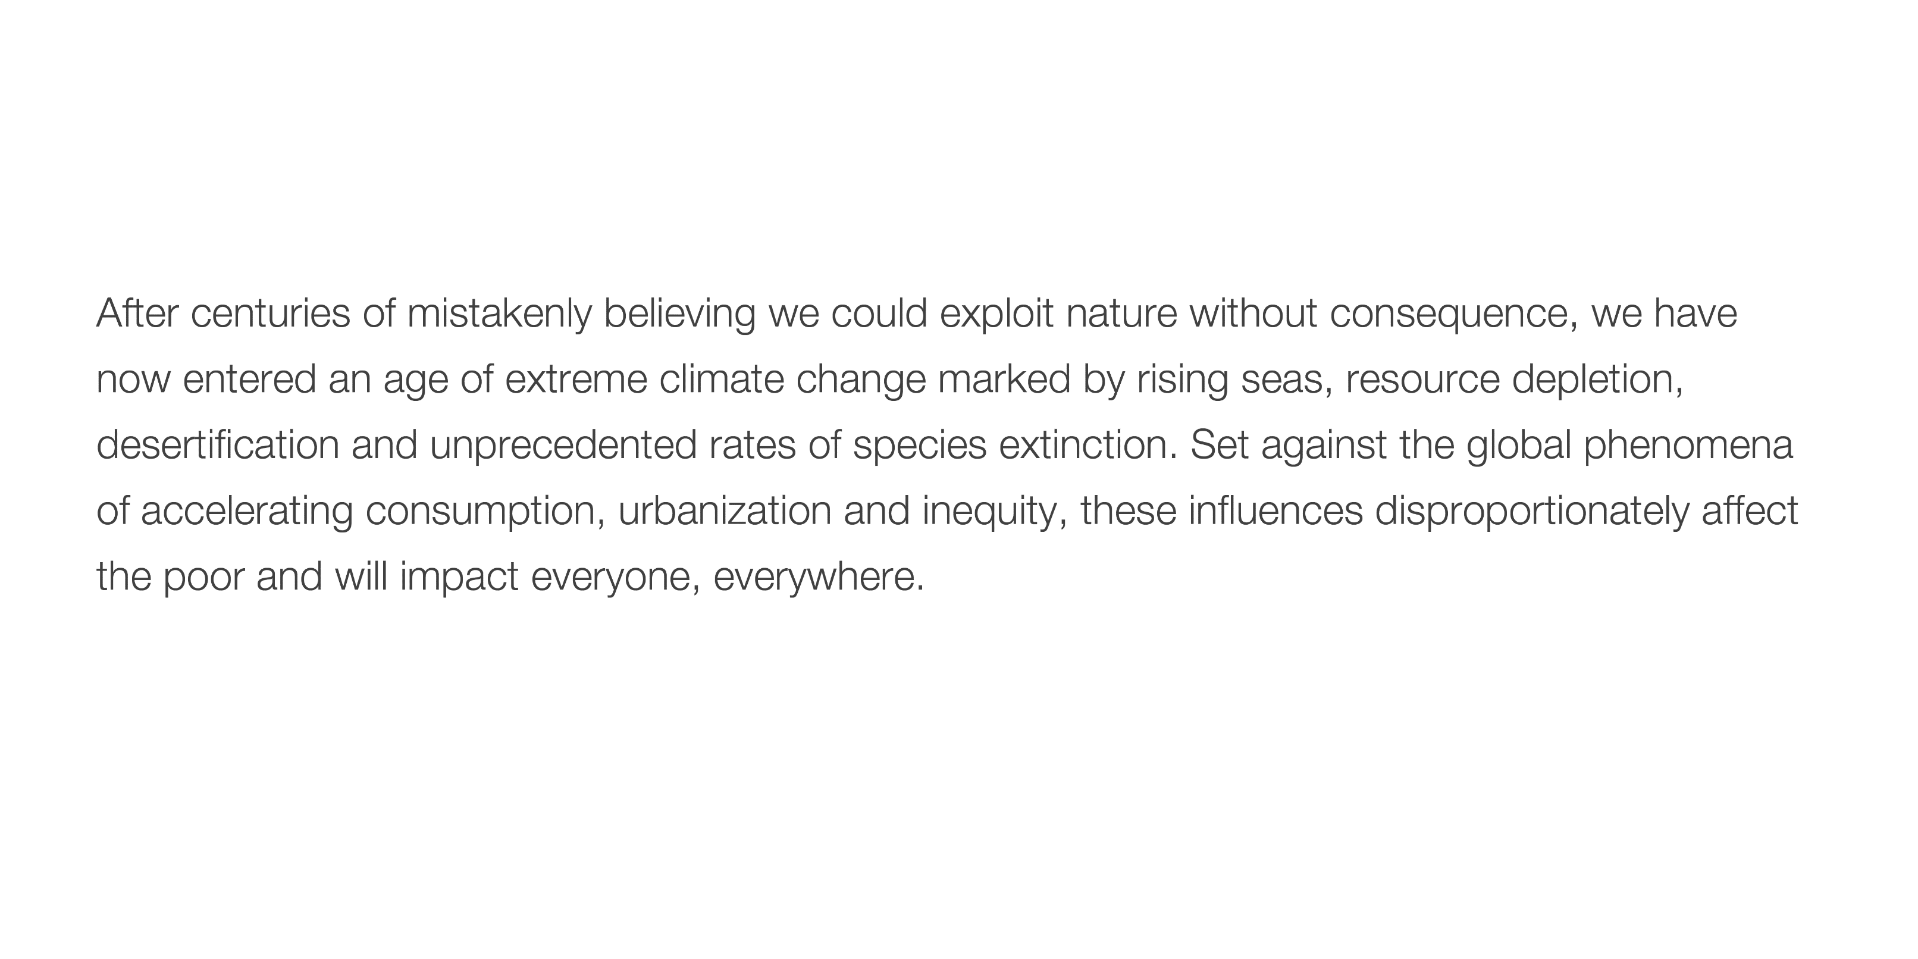

Slide 33
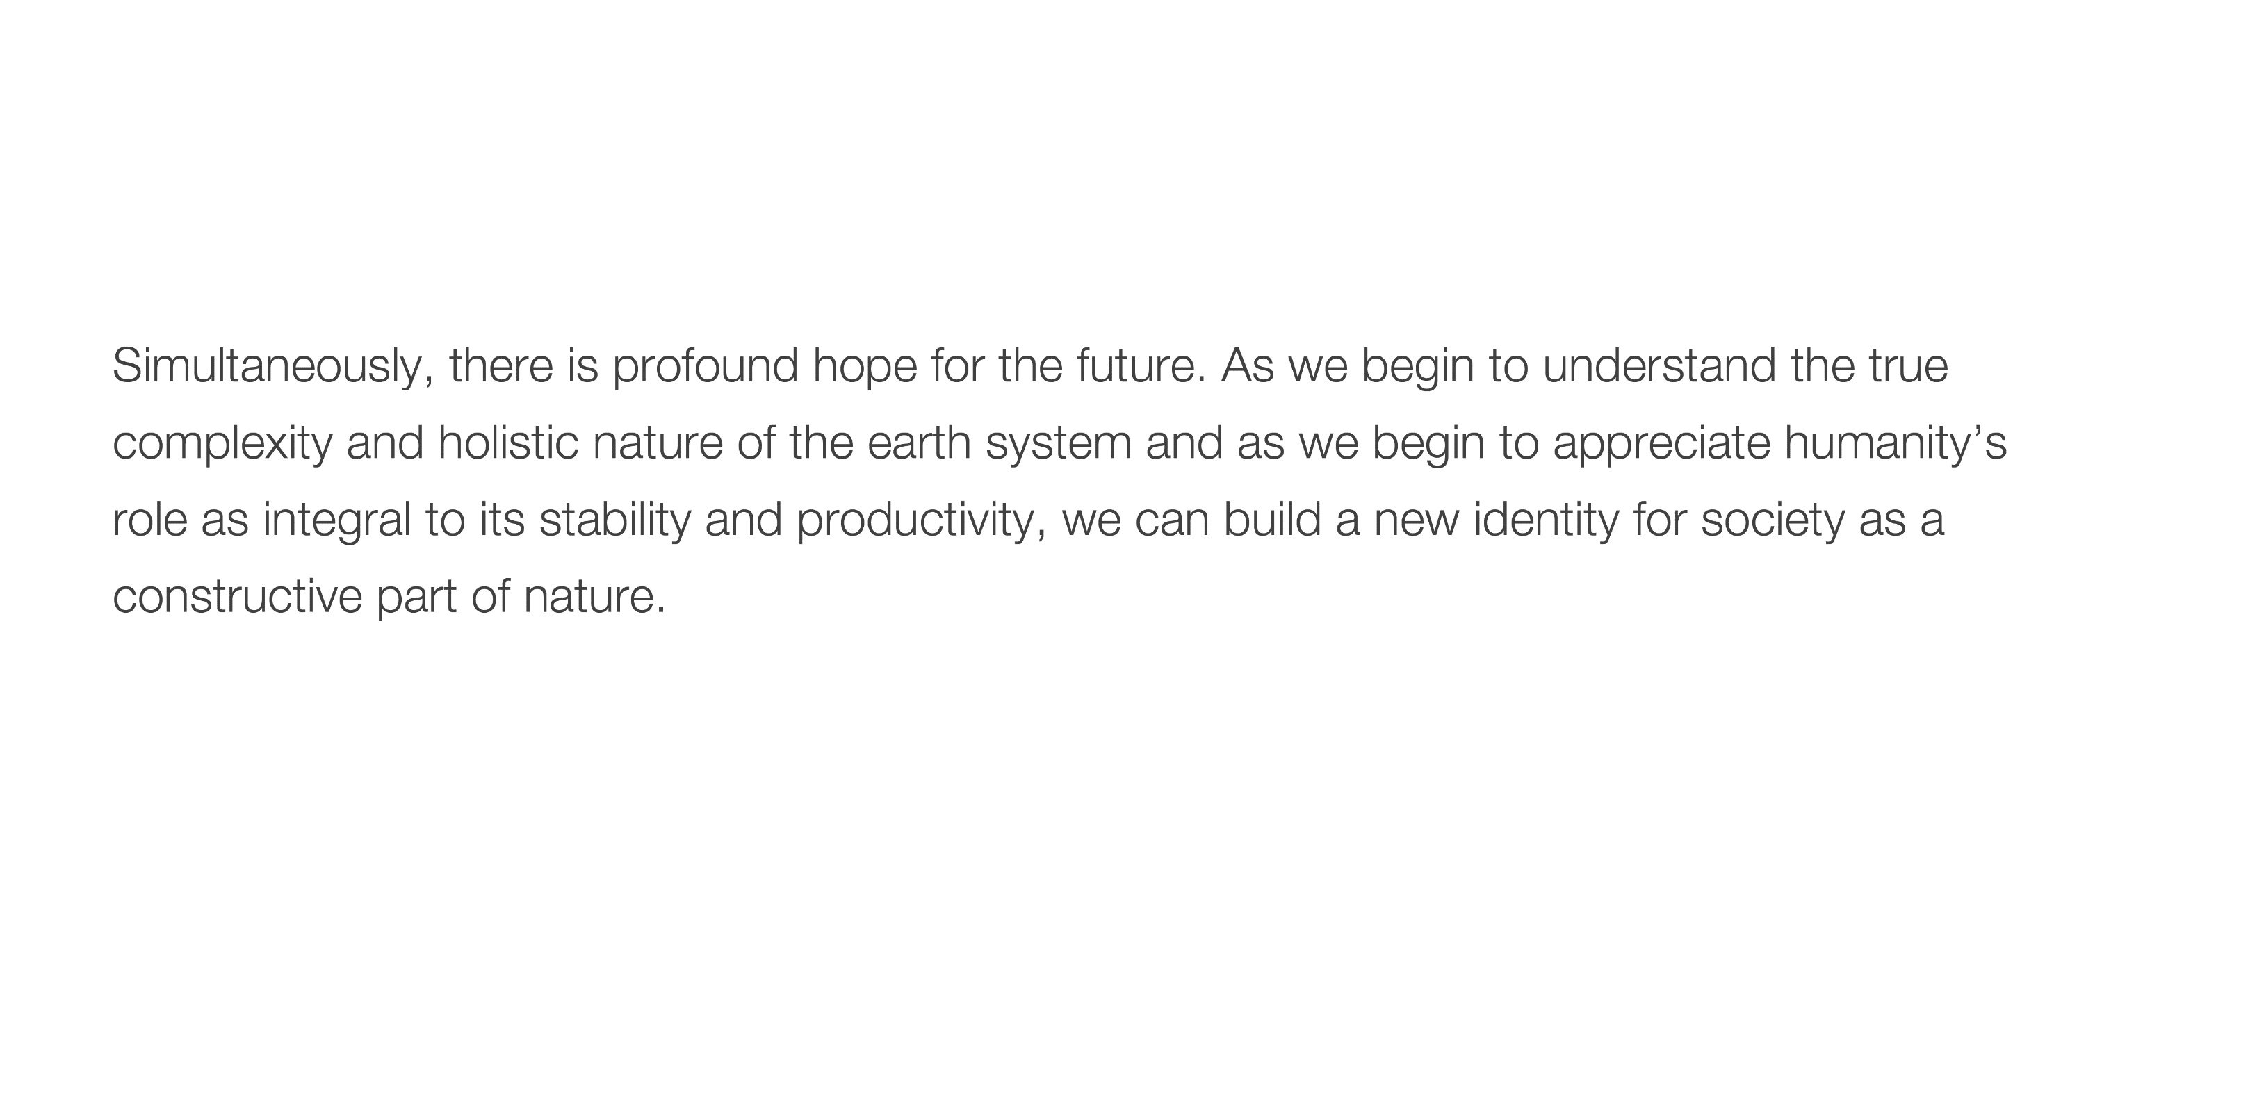

Slide 34
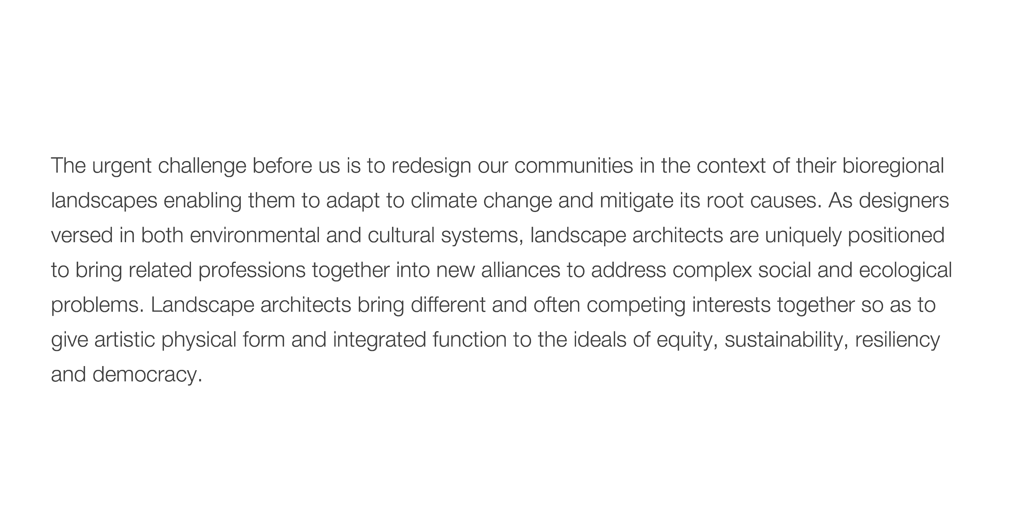

Slide 35
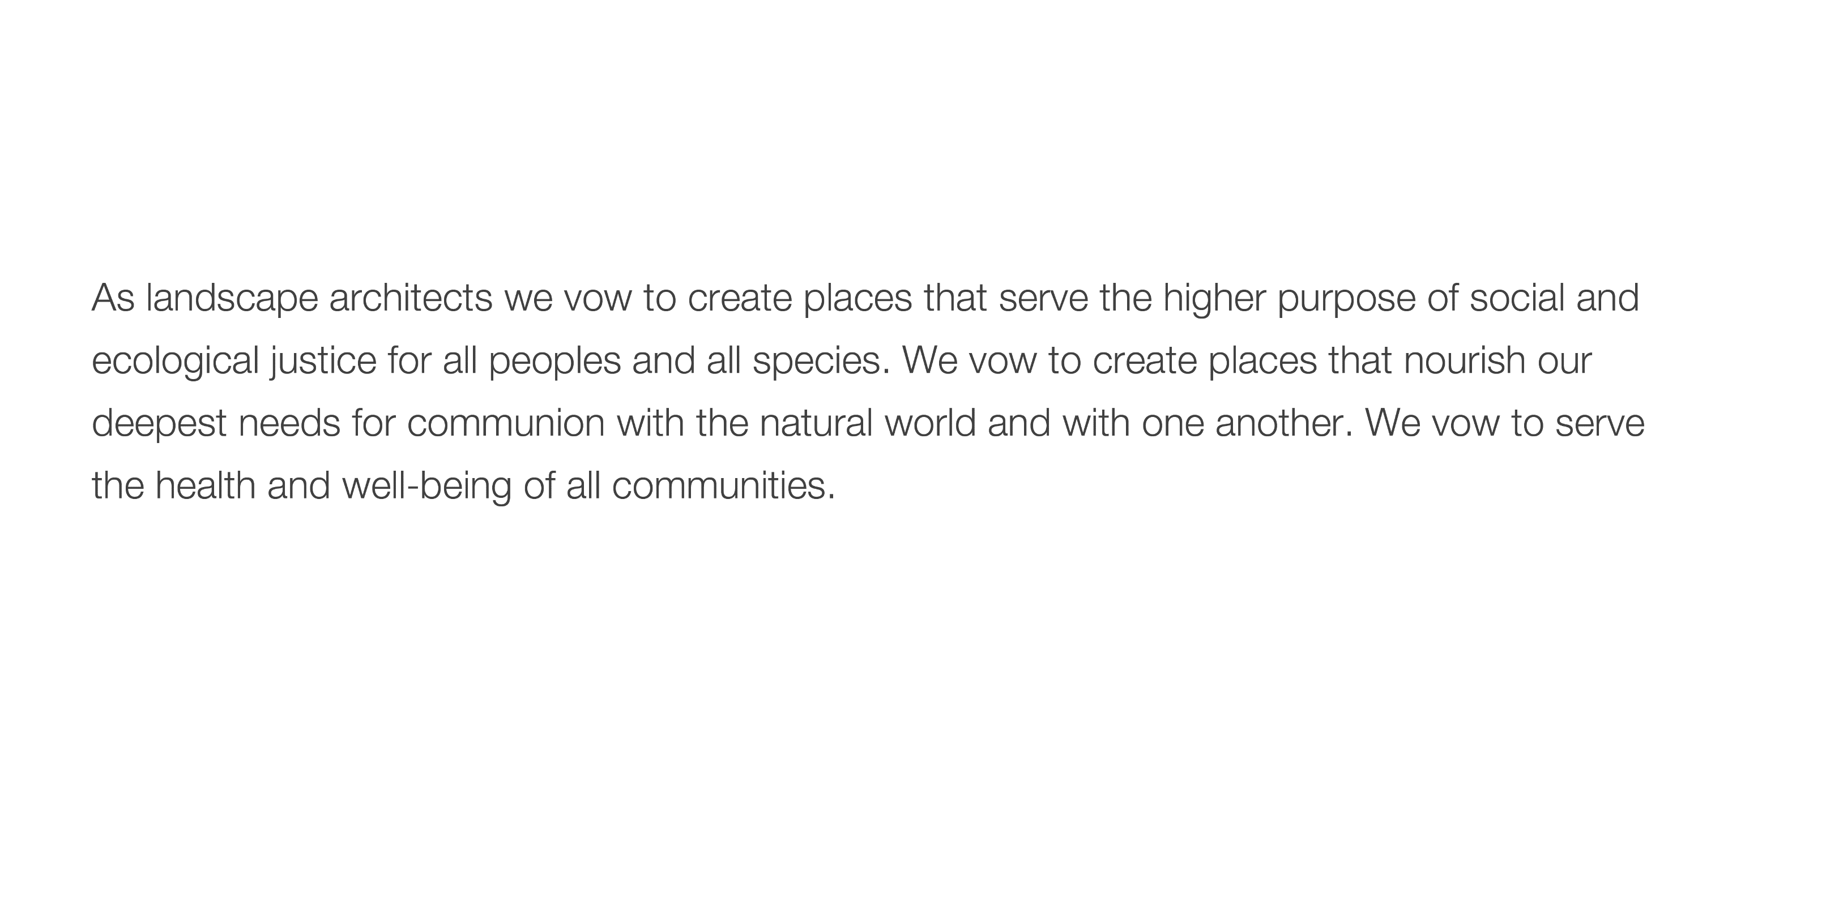

Slide 36

Notes:
Not enough to be a good designer-- need to be an active designer. Find and use your voice. Inform policy and decision-making

Slide 37

Notes:
If you feel inspired, please go to the LAF website and join the hundreds who have already signed on to the Declaration.

Slide 38
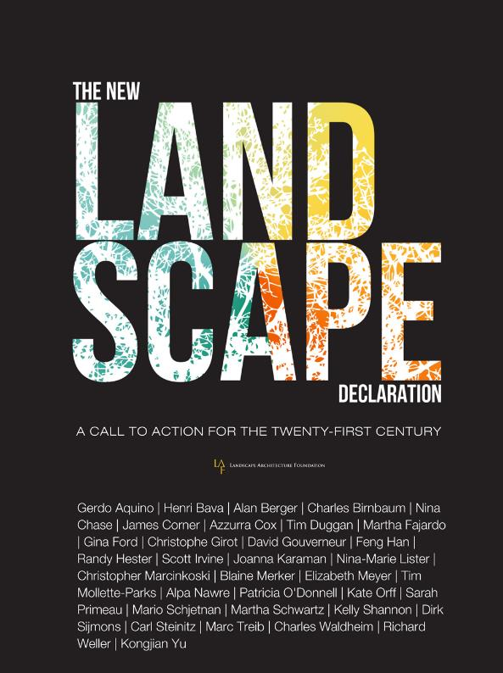
DECLARATION BOOK
“The 32 declarations collected here are good to think with. Each has some wisdom that will help you form your own answers to the challenges the New Landscape Declaration presents.”
Includes:
  LAF’s 1966 Declaration of Concern
  32 “Declarations” by leading thinkers
  Excerpts from panel discussions
  New Landscape Declaration
Notes:
Names in image are the declaration/essay authors + Richard Weller (opening essay) + Beth Meyer (historical context chapter from her transcript). I did not include the panelists here in this graphic.
Quote taken from Richard’s opening essay. An alternative quote is:
“These documents provide us with a historical opportunity to survey the profession’s state of mind and speculate on its future.”

Slide 39
DISCUSSION
What do you think are the defining issues of our time?
How does landscape architecture help solve these issues?
How will you integrate these values into your work and organization?
  Create places that serve the higher purpose of social and ecological justice for all peoples and species
  Create places that nourish our deepest needs for communion with the natural world and with one another
  Serve the health and well-being of all communities
How can LANDSCAPE ARCHITECTS make their VITAL CONTRIBUTION?

Slide 40
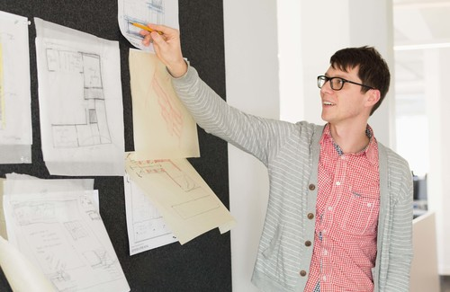
David malda
PHOTO COURTESYLAND 8
ASLA, LEED AP
PRINCIPAL
RESONATE
“After centuries of mistakenly believing we could exploit nature without consequence, we have now entered an age of extreme climate change marked by rising seas, resource depletion, desertification and unprecedented rates of species extinction. Set against the global phenomena of accelerating consumption, urbanization and inequity, these influences disproportionately affect the poor and will impact everyone, everywhere.”
VOLUNTEERISM
PROJECT NAME / DOCUMENT TITLE / MONTH ##, 20## DRAFT/CONFIDENTIAL

Slide 41
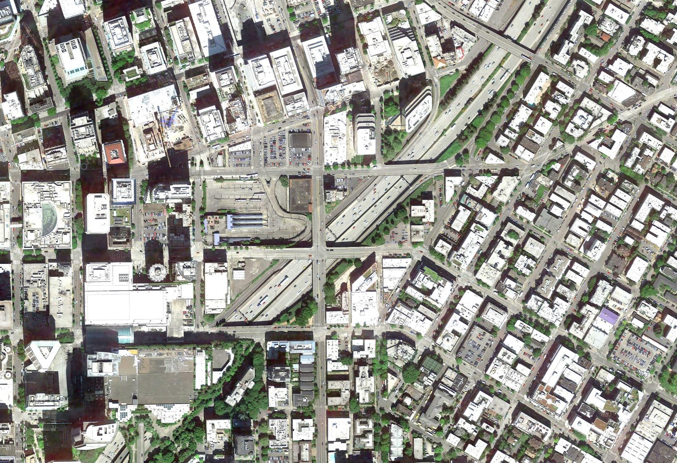
the where and the why

Slide 42
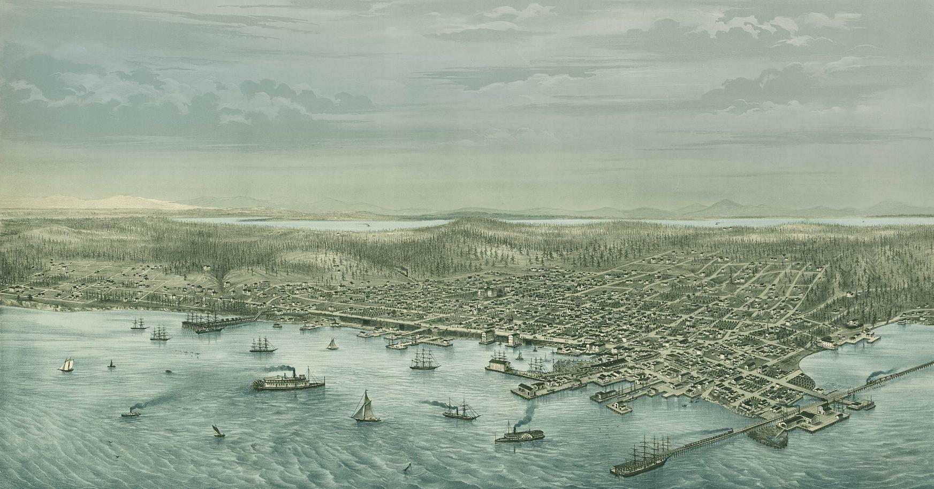

Slide 43
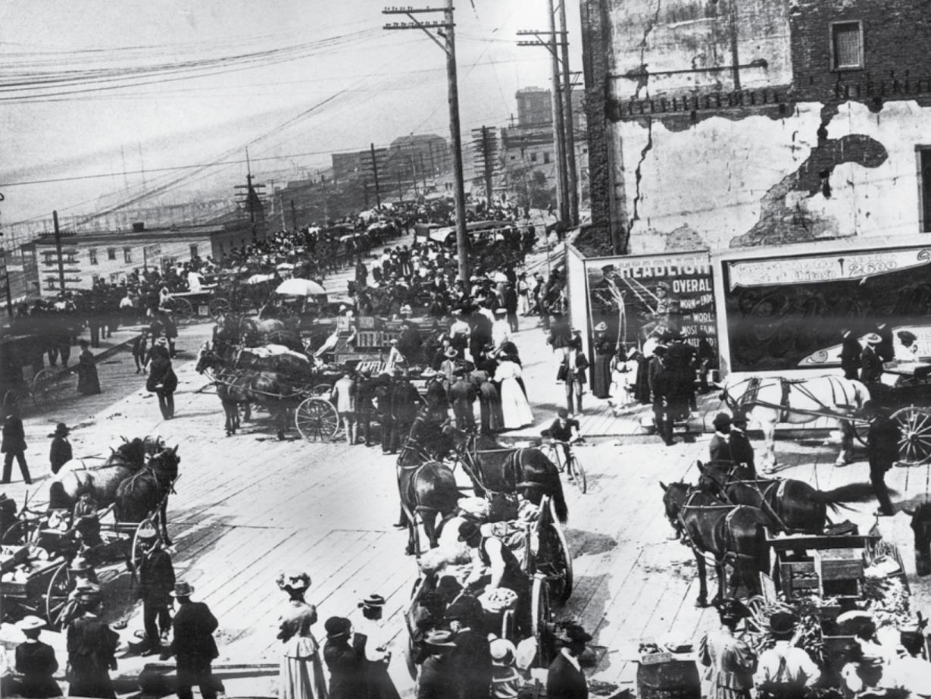

Slide 44
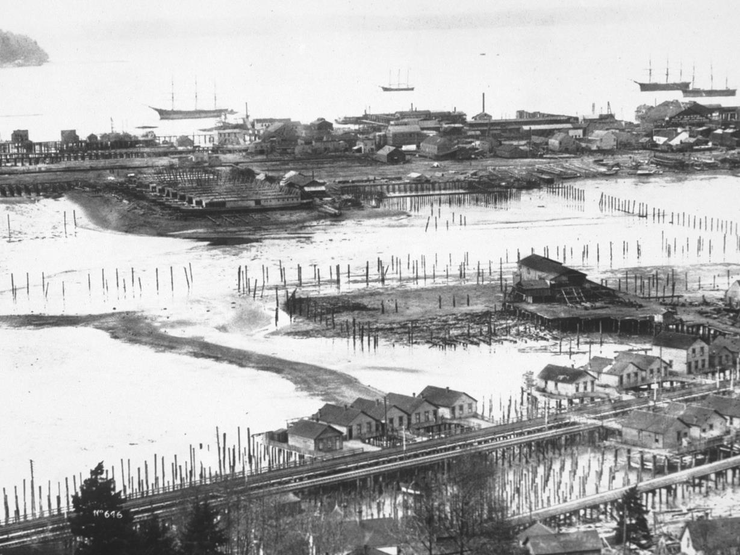

Slide 45
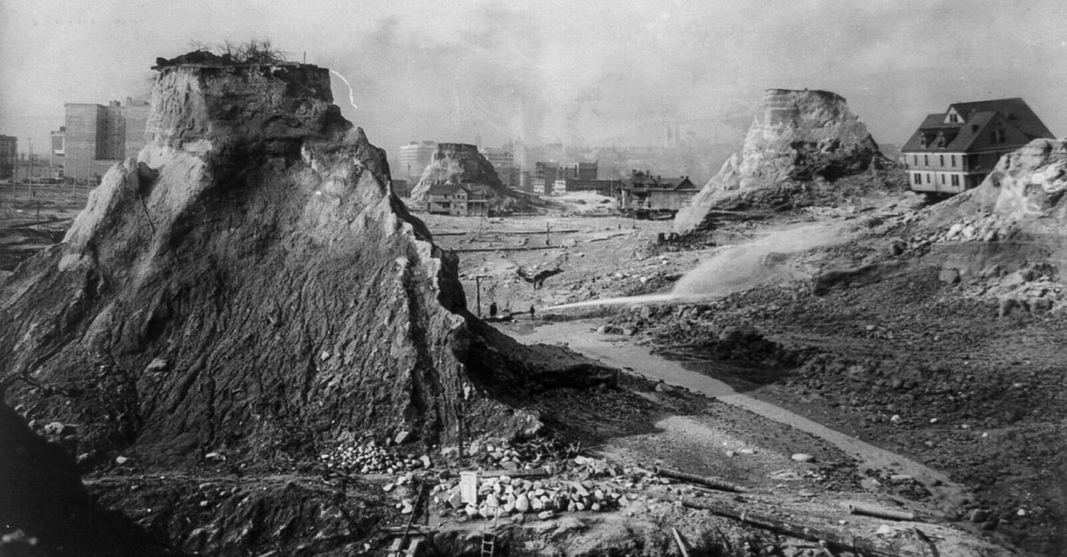

Slide 46
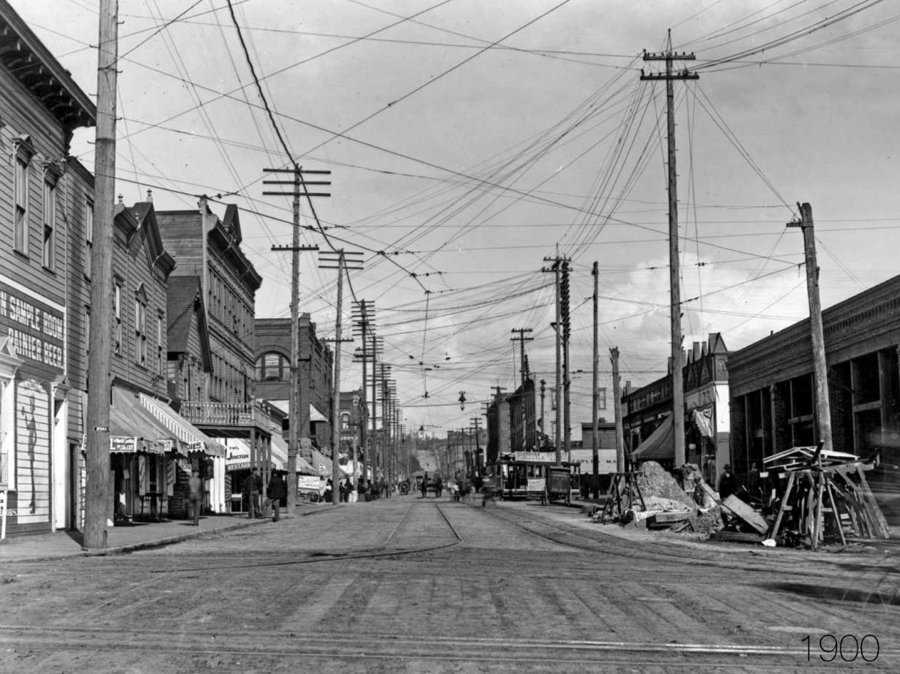

Slide 47
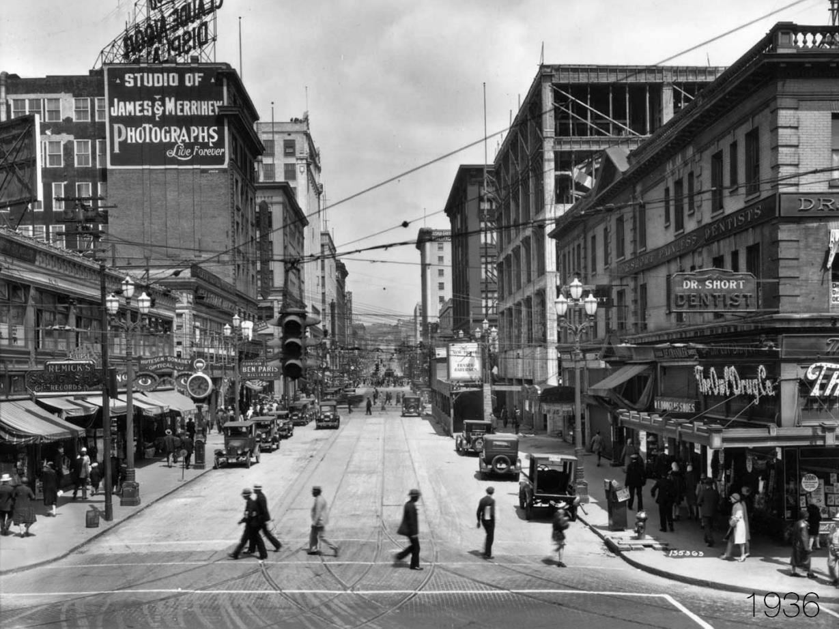

Slide 48
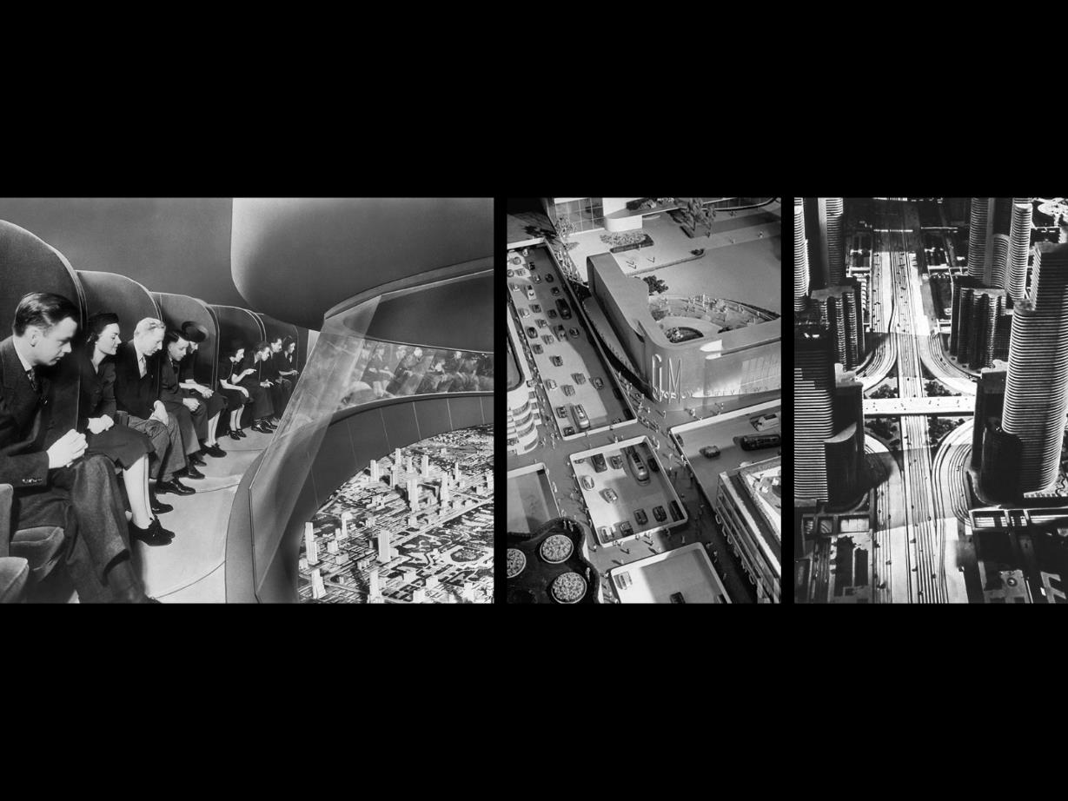

Slide 49


Slide 50



Slide 51


Slide 52


Slide 53


Slide 54


Slide 55


Slide 56


Slide 58


Peg staeheli
PHOTO COURTESYLAND 8
FASLA, PLA
FOUNDING PRINCIPAL
RESONATE
“As designers versed in both environmental and cultural systems, landscape architects are uniquely positioned to bring related professions together into new alliances to address complex social and ecological problems. Landscape architects bring different and often competing interests together so as to give artistic physical form and integrated function to the ideals of equity, sustainability, resiliency and democracy.”
VOLUNTEERISM
PROJECT NAME / DOCUMENT TITLE / MONTH ##, 20## DRAFT/CONFIDENTIAL

Slide 59


Slide 60


Slide 61


Slide 62


Slide 63


Slide 64


Slide 65


Slide 66


Slide 67


Slide 68


Slide 69


Slide 70


Slide 71


Slide 72


Slide 73


Debra guenther
PHOTO COURTESYLAND 8
FASLA, PLA
partner
RESONATE
“Simultaneously, there is profound hope for the future. As we begin to understand the true complexity and holistic nature of the earth system and as we begin to appreciate humanity’s role as integral to its stability and productivity, we can build a new identity for society as a constructive part of nature.”
VOLUNTEERISM
PROJECT NAME / DOCUMENT TITLE / MONTH ##, 20## DRAFT/CONFIDENTIAL

Slide 74

North Richmond
Resilient by Design—
Notes:
To turn off the logo on any page:
Select the logo. Go to the HOME tab and click on the Select icon. Use the drop down menu to open the Selection Pane and click the eye icon. It will change to a line and the logo will no longer be visible, but will still be there if needed.
To add an em dash (long hyphen): Go to Insert > Symbol, make sure the font box says Century Gothic, select the em dash and click Insert. Or copy and paste this: —

Slide 75

10 Project Areas
  In January, 10 Design Teams were matched with 10 sites around the Bay Area that represent a range of issues, terrain, and communities.
  Over the next 5 months, the Mithun Home Team will work with North Richmond to design resilient solutions for the neighborhood and surrounding area that reflect community priorities.
Notes:
Selected from a pool of 76 community suggested sites, the 10 unique places will enter the next stretch of the Challenge: the Collaborative Design Phase. Sites selected are vulnerable to the impacts of climate change, facing daily threats to their resilience.

Slide 76


Slide 77


Slide 78

From Subject Received Size Categories
Debra Guenther 11:47 PM 4 MB

Slide 79


Slide 80


Slide 81

CAB
Stats:

Slide 82


Slide 83


Slide 84

Dorothy faris
PHOTO COURTESYLAND 8
PLA
PRINCIPAL
RESONATE
VOLUNTEERISM
“To fulfill these promises, we will work to strengthen and diversify our global capacity as a profession. We will work to cultivate a bold culture of inclusive leadership, advocacy and activism in our ranks”
PROJECT NAME / DOCUMENT TITLE / MONTH ##, 20## DRAFT/CONFIDENTIAL

Slide 85



Slide 86


5
SUMMIT
PROJECT NAME / DOCUMENT TITLE / MONTH ##, 20## DRAFT/CONFIDENTIAL
LAF SUMMIT 2016

Slide 87





14

Slide 88
We will work to cultivate a bold culture of inclusive leadership, advocacy and activism in our ranks.
14

Slide 89



PHOTO COURTESYLAND 8
PROJECT NAME / DOCUMENT TITLE / MONTH ##, 20## DRAFT/CONFIDENTIAL
VOLUNTEERISM

Slide 90

PHOTO COURTESYLAND 8
PROJECT NAME / DOCUMENT TITLE / MONTH ##, 20## DRAFT/CONFIDENTIAL
SUMMIT
GEORGETOWN

Slide 91
We will work to support research and champion new practices that result in design innovation and policy transformation.
14

Slide 92

R+D LIFE CYCLE ANALYSIS

Slide 93

14
R+D POLLINATORS

Slide 94


STORMWATER METRICS

Slide 95
We will work to strengthen and diversify our global capacity as a profession
14

Slide 96




PHOTO COURTESYLAND 8
PROJECT NAME / DOCUMENT TITLE / MONTH ##, 20## DRAFT/CONFIDENTIAL
DIVERSE ENGAGEMENT

Slide 97

PHOTO COURTESYLAND 8
PROJECT NAME / DOCUMENT TITLE / MONTH ##, 20## DRAFT/CONFIDENTIAL
DIVERSE ENGAGEMENT
PRO BONO

Slide 98


Slide 99
DISCUSSION
What do you think are the defining issues of our time?
How does landscape architecture help solve these issues?
How will you integrate these values into your work and organization?
  Create places that serve the higher purpose of social and ecological justice for all peoples and species
  Create places that nourish our deepest needs for communion with the natural world and with one another
  Serve the health and well-being of all communities
How can LANDSCAPE ARCHITECTS make their VITAL CONTRIBUTION?

Slide 100

PHOTO COURTESYLAND 8
PROJECT NAME / DOCUMENT TITLE / MONTH ##, 20## DRAFT/CONFIDENTIAL
SUMMIT
MOVE FORWARD

