Slide 1
2018 WASLA CONFERENCE
RESONATE / DISSONATE
The challenges and potential of designing with urban water
MODERATOR
Nancy Chan, Urban Designer, Hewitt
Jake Woland, Sr. Associate Landscape Architect, Hewitt
Molly Freed, Policy Coordinator, The Living Future Institute
Brook Jacksha, Principal, Navix Engineering
PANELISTS

Slide 2
18th of June, 2018

Slide 3
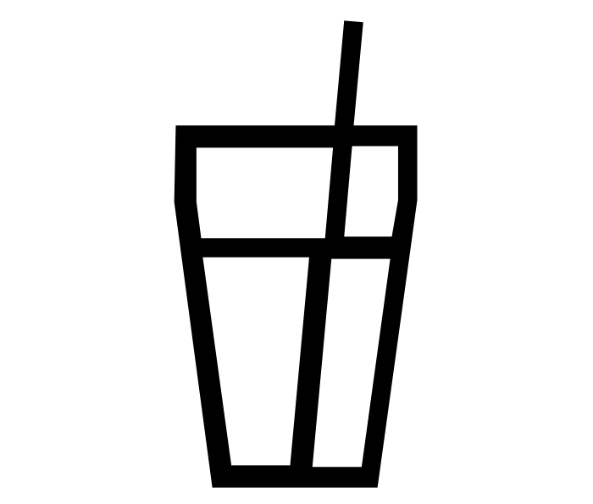
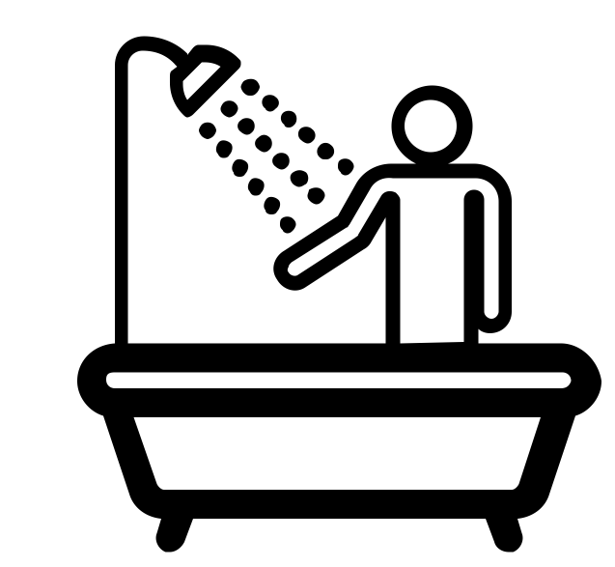
½ GALLON
OF WATER FOR DRINKING
PER DAY
3 GALLONS
OF WATER
FLUSHING A TOILET
17.2 GALLONS OF WATER
8 MIN. SHOWER
10 GALLONS
OF WATER
TOOTHBRUSHING, HANDWASHING, COOKING
80
13
gallons
gallons

Slide 4
The US just had the most expensive year for weather disasters in history.
Expect More.
Source: Quartz, https://qz.com/1181319/disasters-2017/
Hurricane Harvey, Houston, TX
Wildﬁres,Cascade Locks, Ore.
Wildﬁre smoke, Walla Walla WA
Oroville Dam Crisis, CA
Midwest Tornados
Wildﬁres, CA
Drought, Montana
Hailstorm, Colorado

Slide 6
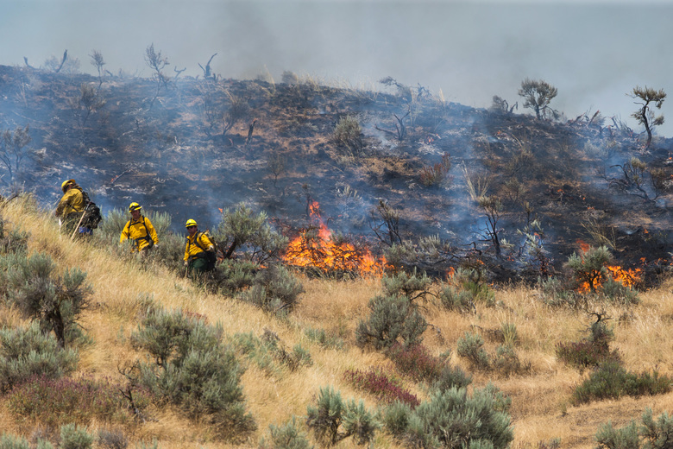

Slide 7
2018 WASLA CONFERENCE
RESONATE / DISSONATE
The challenges and potential of designing with urban water
MODERATOR
Nancy Chan, Urban Designer, Hewitt
Jake Woland, Sr. Associate Landscape Architect, Hewitt
Molly Freed, Policy Coordinator, The Living Future Institute
Brook Jacksha, Principal, Navix Engineering
PANELISTS

Slide 8
AN EVOLUTION OF PRACTICE
WITH LOCAL CODES AND REGULATIONS
LANDSCAPE ARCHITECTURE

Slide 9
The Early Years
2004 Lumen, Seattle, WA

Slide 10
Pre-Stormwater Code and Green Factor
2007 Mural Apartments, Seattle, WA

Slide 11
Green Factor
2010 Greenhouse Apartments Seattle, WA

Slide 12
Stormwater Code- Max Extent Feasible
2014 Block 44 Amazon, Seattle, WA

Slide 13
Holistic Design
2016 The Douglas and James Court Park, Seattle, WA

Slide 14
Holistic Design
2016 The Douglas and James Court Park, Seattle, WA

Slide 15
Collaborative Opportunity
2016 8th & Republican, Seattle, WA

Slide 16
Collaborative Opportunity
2016 The Eleanor, Seattle, WA

Slide 17
Block 25 Site
Block 31 Site
3
4
2
1
5
New Stormwater Code and Beyond
Open 2019 Lakefront Blocks- Google, Seattle, WA

